Slide 1



Pathogenesis and molecular epidemiology of Ostreid herpesvirus 1 (OsHV-1) in China
VIVALDI Stakeholders' workshop
Chang-Ming BAI
Yellow Sea Fishery Research Institute, CAFS
Montpellier, August 2018

Slide 2
China: the biggest mollusc producer
China produce about 40 % of molluscs of the world in recent years (FAO).
Notes:
As we known, China is the biggest producer of mollusc around the world. We produced more than 10 million tons of shellfish each year recently, which account for about 40% of the world.

Slide 3
Mollusc productions of China
In 2016, the total mollusc production was 14 207 501 tons
Notes:
In 2016, China produced over 14 million tons of mollusc. The Oysters, clams and scallops were the first three kinds of shellfishes cultivated in China.

Slide 4
Important mollusc pathogens in China
Many diseases have immerged since 1990s due to the introduction of intensive cultivation techniques.
1. Perkinsus spp.
2. Marteilia spp.
1. Vibro spp.
2. Rickettsia-like organism
1. Ostreid herpesvirus 1
2. Haliotid herpesvirus 1
Sporadic
Locally
Epidemic
Notes:
Many diseases have immerged since 1990s as the introduction of intensive cultivation. Pathogens identified as parasites, bacterial and virus have been found associated with these disease. Mortalities associated with parasites and bacterial infection always occurred sporadically and locally. While two herpesvirus diseases have caused mass mortalities and great economic loss across large regions.

Slide 5
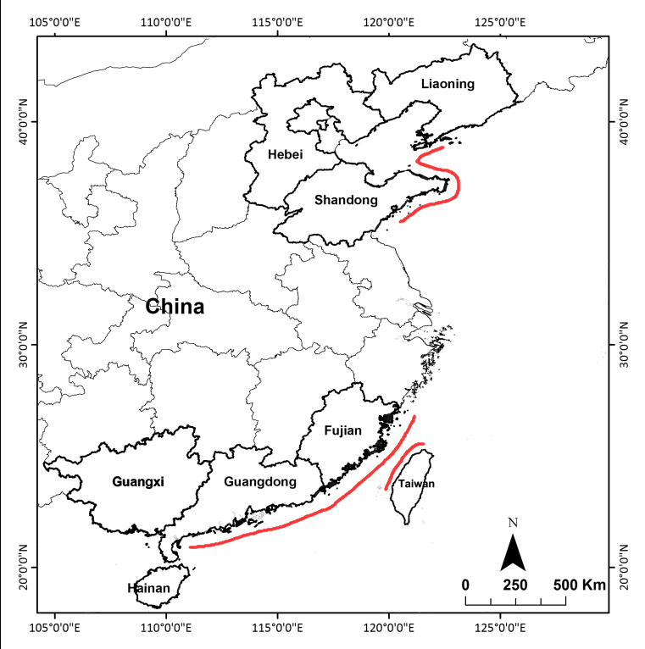
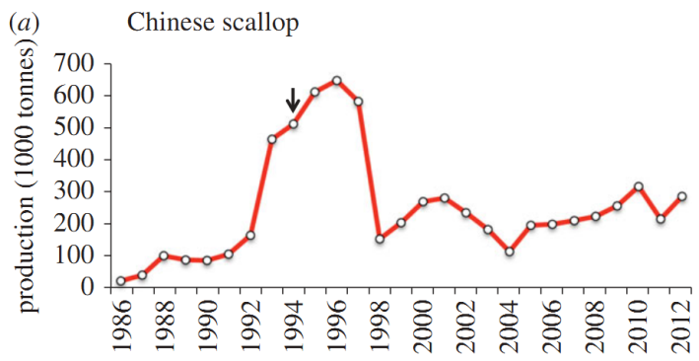
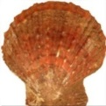
Mass mortalities associated with Herpesvirus diseases
Guo & Ford, 2016
AVNV infection
AVNV is a variant of OsHV-1.
Small abalone (Haliotis diversicolor) has been replaced by Pacific abalones (H. discus) since 1999 (Nie & Wang. 2004).
HaHV-1 infection
Notes:
The first one of Ostreid herpesvirus 1 infection occurred on Chinese Scallops. The scallops have been cultivated widely along the northern coast. The production has mounted to about seven hundred thousand tons before the disease occurred in 1996. While the recurrent outbreak of mass mortalities associated with Ostreid herpesvirus 1 infection made its production reduced to less than two hundred thousand tons in 1998, about one third of that in 1996.
A similar situation also occurred on cultivated small abalones in southern China in 1999 associated with abalone herpesvirus infection.

Slide 6

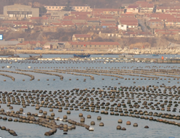
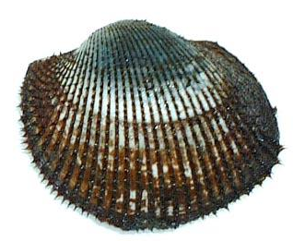
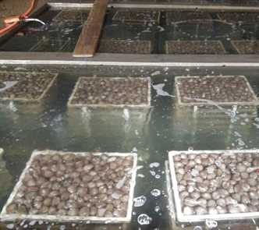
Bivalve Herpes-like viral disease in China
Summer, 1997-2010
Chlamys farreri in the wild
Adult and Juvenile
>23 ℃
AVNV
Summer, 2012-2016
Scapharca broughtonii in hatchery & factory
Adult
>16-18 ℃
OsHV-1-SB
Wang et al, 2004
Bai et al, 2016
Mortalities of Pacific oyster larvae associated with OsHV-1 infection occurred several times (Li Li, IOCAS, per. Com.)
Notes:
Here, I will focus on the OsHV-1 infection in China. Apart from mass mortalities of Chinese scallop mentioned just now, another case of mass mortalities associated with OsHV-1 occurred on ark shells between 2012 and 2016. The mortalities only occurred in hatcheries or factories. This may be because the ark shells is a Benthic species and naturally live at the sea bed, where the temperature is always between 5 and 15℃ degree Celsius.
Additionally, Mortalities of Pacific oyster larvae associated with OsHV-1 infection occurred several times.

Slide 7
Intricate OsHV-1 infection in China
Mortality of Chinese scallop with OsHV-1 detection
Only OsHV-1
DNA detection
Mortalities of ark sells
with OsHV-1 detection
#
1997 2010 2012 2017
#: OsHV-1 DNA has not been detected in all shellfish samples by us in northern China.
While OsHV-1 DNA was detected in healthy Scapharca subcrenata in southern China in Sep 2017 (Gao et al. 2018, JVM).
Production of Chinese scallop Guo & Ford, 2016
Notes:
The intricate OSHV-1 disease occurred in China.
All of the data was based on passive and active surveillance of our team, personal communications with colleagues and known publications et al. There is no national mollusc health or pathogen surveillence network now in China.

Slide 8
Deduced reasons for the incricate OsHV-1 disease in China
For the affected Chinese scallops and ark shells:
  High density
  High temperature
For unaffected Pacific oyster cultivation: Pacific oyster culture depend on naturally collected spats in China. Hatchery-produced larvae for research were affected by OsHV-1 infection (LiLi IOCAS per. com.).
Why unaffected now:
  Reducing density
  Low temperature (<10 ℃)
  Resistant families
Notes:
For all affected population, they have been cultivated in high densities in relatively high temperature.
Now it seems that the OsHV-1 were disappeared from Chinese scallops and ark shells. We deduced possible reasons were:
Reducing density for Chinese scallops cultivated in open sea.
Low temperature (<10 ℃) for ark shells cultivated in factory waiting for exports.
Resistant families for ark shells cultivated hatcheries for larvae production. Many all shell populations were naturally resistant to the OsHV-1 infection. And the production of ark shell larvae in hatcheries was supported by a governmental project to increase ark shell stock by releasing cultivated spat to the open sea. Now the project was terminated and production of hatchery-produced larvae reduced significantly.

Slide 9
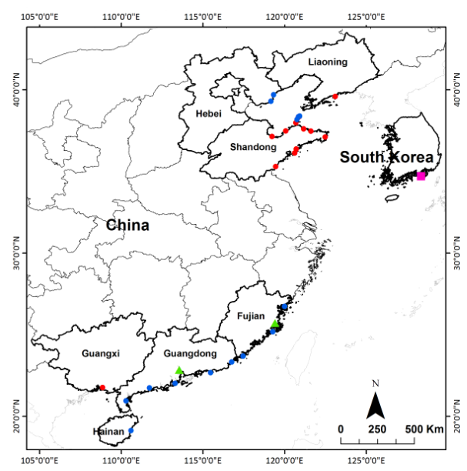
Differentiation and diversity of OsHV-1 in China——a retrospective study
338/1599 samples
  16/29 regions
  7/ 18 species
  2001-2013
C2/C6 variation
24 variants
Notes:
Although mass mortalities associated with OsHV-1 infection were observed only in three species in northern China. A retrospective study has shown that the viral DNA could be detected in seven species and southern China. The retrospective study was conducted on 1599 samples collected between 2001 and 2013. we found 338 positive samples from 16 regions and 7 species using C2/C6 primers.
Analyzing of the sequences of these PCR products resulted in 24 variants.

Slide 10
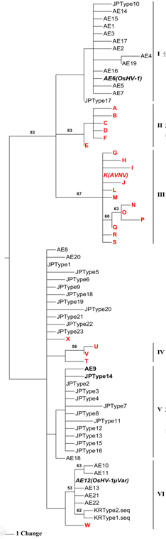
OsHV-1 related
MP tree established on variation of C2/C6 region
Japan & France
2012-2013, China
2001-2010, China
Chinese scallop
OsHV-1µVar related
These results is preliminary, because C2/C6 is too short.
2011, China
2010-2011, Oyster
Japan & New Zealand
After 2008, France, Ireland, China and South Korea
Bai et al. 2015
Notes:
After comparing of the 24 variants with those found in other countries, we found the variants identified from different countries and time prior to allocated together. This results indicated that the differentiation of OsHV-1 maybe influenced by its temporal and spatial distribution.
However, phylogenetic relationships among many variants could not be determined, because C2/C6 is too short.

Slide 11
Problems and solutions
C2/C6 is short in length (700+ bp)
More data
HTS
Viral DNA
Methods for purifying viral DNA
Cell lines
High-speed centrifugation
Targeted genomic enrichment
Targeted genomic
amplification
Notes:
To solve this problem, we need much more genetic data. So high-throughput sequencing technology were selected by us. However we need enough high purity viral DNA for high-throughput sequencing .
Four methods have been used for obtaining high-purity viral DNA previously, Which include cell lines, High-speed centrifugation, Targeted genomic enrichment and Targeted genomic amplification.
After comparison, We selected the targeted genomic amplification with Long-rang PCR to get OsHV-1 DNA for high throughput sequencing.

Slide 12
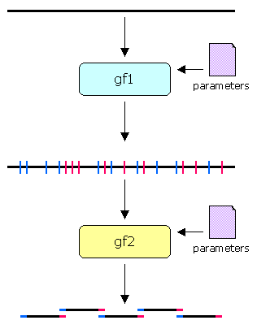
Primer selection and fragmentation
25 bp in legnth
12% GC content
……
3693 primer pairs
9-11 KB in length
0.5-1.5 KB overlap
……
GenoFrag (Ben Zakour et al., 2004)
Notes:
We designed primers with GenoFrag software. Firstly, 3693 primer pairs were generated according to the reference genome of OsHV-1 and defined primer parameters. Then the a set of 23 primers were automatically picked out from the primers bank according to the defined parameters.
The 23 primers covering 99.3% of the OsHV-1 reference genome.

Slide 13
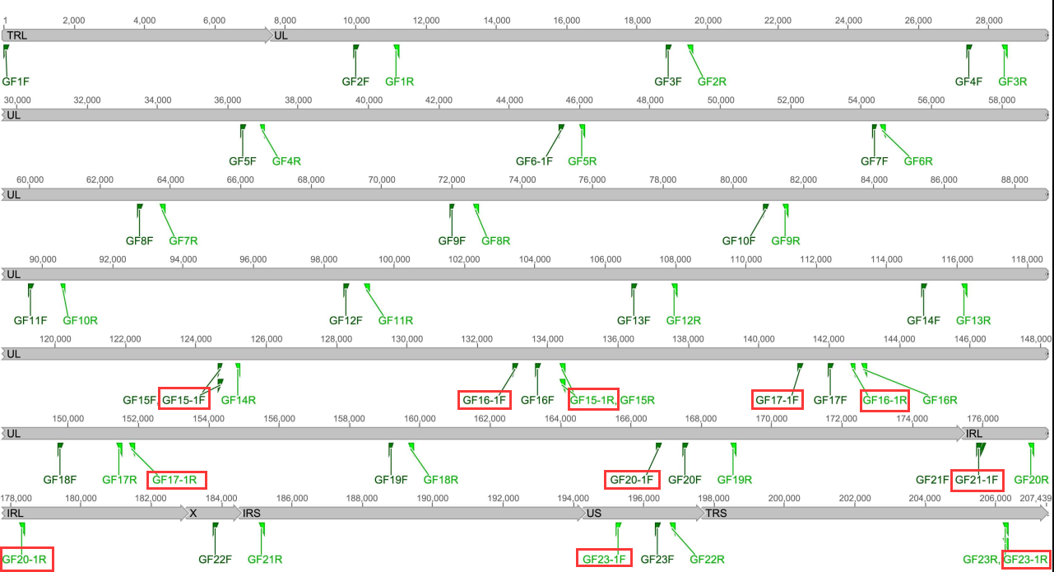
Genomic distribution of primer pairs
If the automatically selected primers does not work in some samples, new primers were manually selected from primer bank around them.
Notes:
If the automatically selected primers does not work in some samples, new primers were manually selected from primer. As labeled by red square.

Slide 14
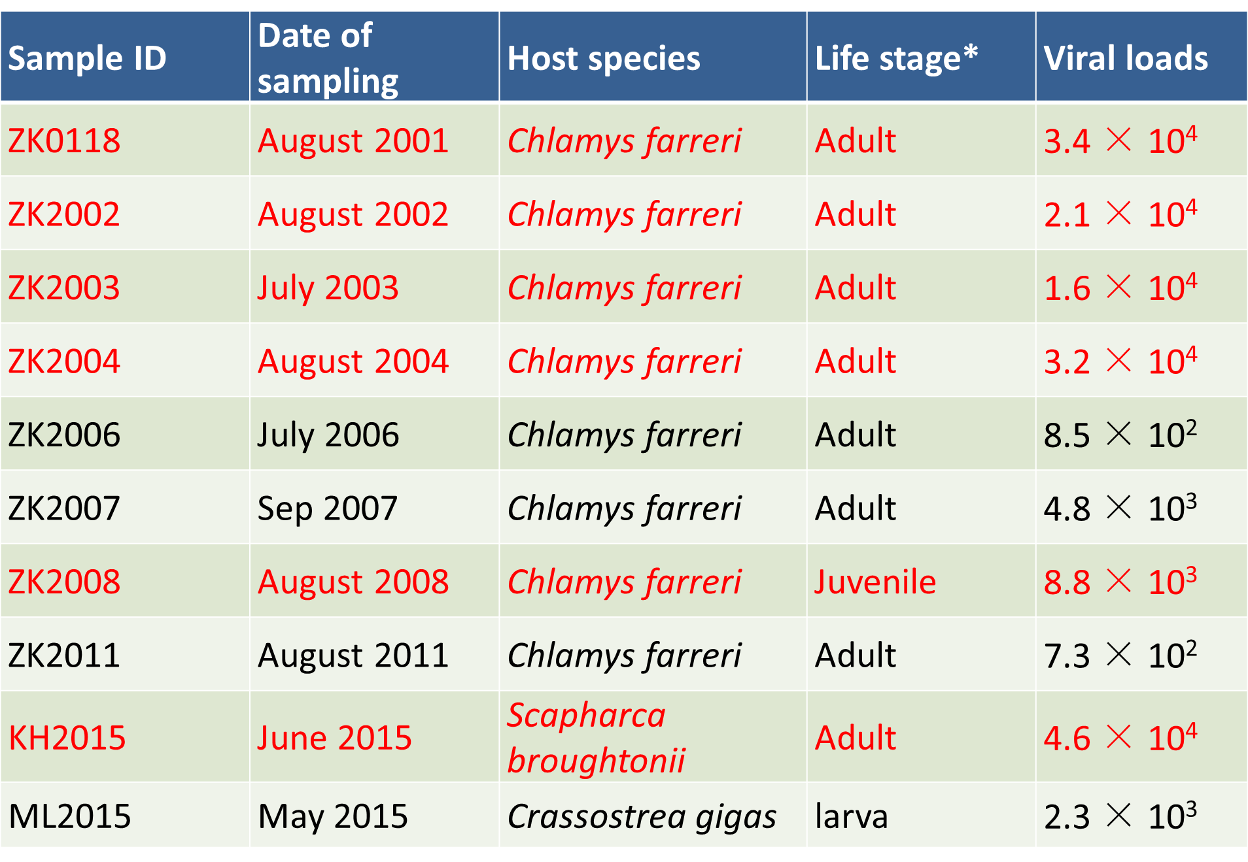
Summary of 10 selected samples
Items printed in red were successfully amplified
Notes:
10 samples with different epidemiological features and different grade of viral loads were selected for PCR. Finally, six of them with relatively high viral loads were successfully amplified.

Slide 15
Long-rang PCR of OsHV-1
Purification of each PCR product
Quantification of each PCR product
Mixed in equimolecular proportions
Notes:
This picture is an example of the electrophoretic bands generated from 23 PCR products of one sample.
The PCR products were then purified and qualified individually, then 23 PCR products from one sample were mixed in equimolecular proportions and send for sequencing with Illumina, and one of them were also sequenced with Pacbio.

Slide 16
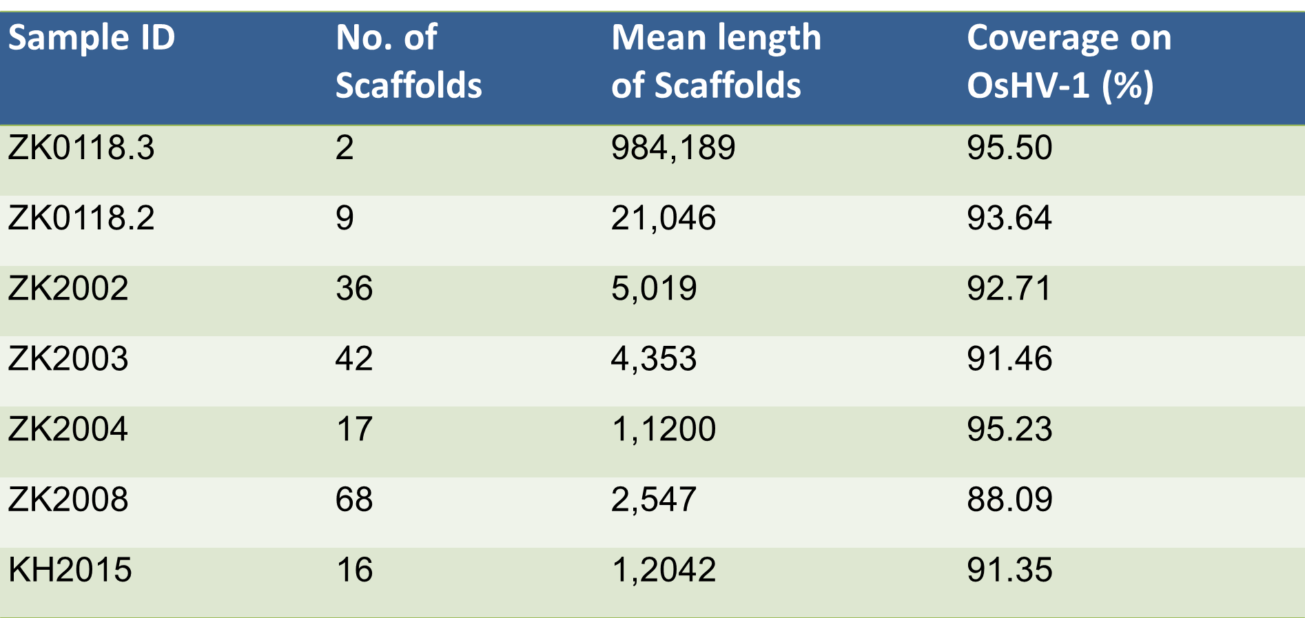
Summary of HTS results
Two scaffolds were recovered from PacBio reads compared to 9 - 68 scaffolds from Illumina reads.
Notes:
Two scaffolds were recovered from PacBio reads compared to 9 to 68 recovered from Illumina reads.

Slide 17
Coverage across the genomes
The overall coverage is unbiased and satisfying, except for the terminal repeat regions and some PCR products, especially GF 16.
Notes:
The overall coverage is unbiased and satisfying, except for the terminal repeat regions and some PCR products, especially GF 16.

Slide 18
Unexpected problems with GF16
GF16 is located in the UL region
When one of the failed samples was amplified with GF16-1F/R, sequence reads could be obtained.
Primers | No. of samples | Amplification | Reads
GF16F/R | 5 | + | -
GF16-1F/R | 2 | + | +
Notes:
GF16 is located in the Unique Long region of OsHV-1 genome.
Two sets of primers were selected for amplification. Although PCR products were obtained from all of them. But no reads generated from one set of the primers.
When one of the failed samples was amplified with GF16-1F/R, sequence reads could be obtained. We can not figure out the reasons for these failure.

Slide 19
Phylogeny of OsHV-1 variants
OsHV-1 evolution was mainly impacted by its host species rather than spatial segregation.
Notes:
Based on nearly complete genome sequences of the six variants we obtained and those from Genbank, we build a phylogenic tree including eleven variants.
From these tree, we found variants identified from different species prior to allocated together.
So our new finding indicated that OsHV-1 evolution was mainly impacted by its host species rather than spatial or temporal segregation.

Slide 20
Thank you for your attention

